Slide 1

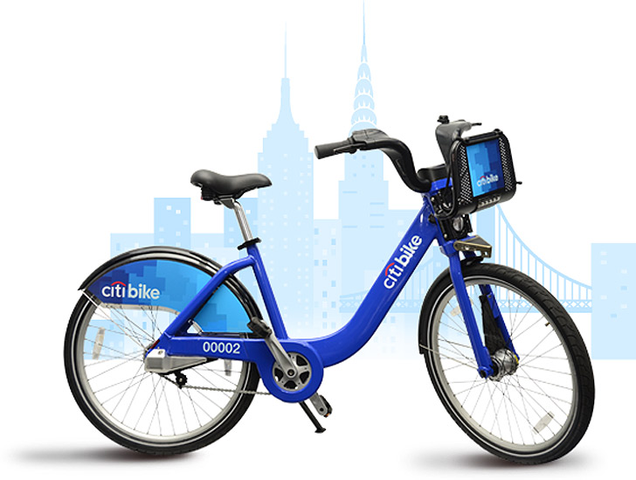
CitiBike Redistribution with Reinforcement Learning
Team
MMAI 845 - Reinforcement Learning & Application

Slide 2

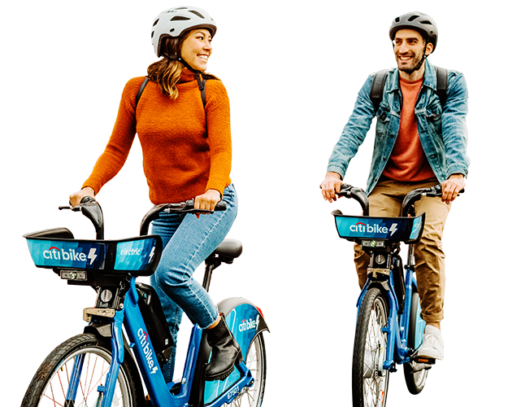
Agenda
“I left my bike beside a wall the other day, and it fell over. It was two tyred.”
CitiBike Overview
Environment & Problem
Solving the problem
Comparing Results
Best method
Next Steps

Slide 3

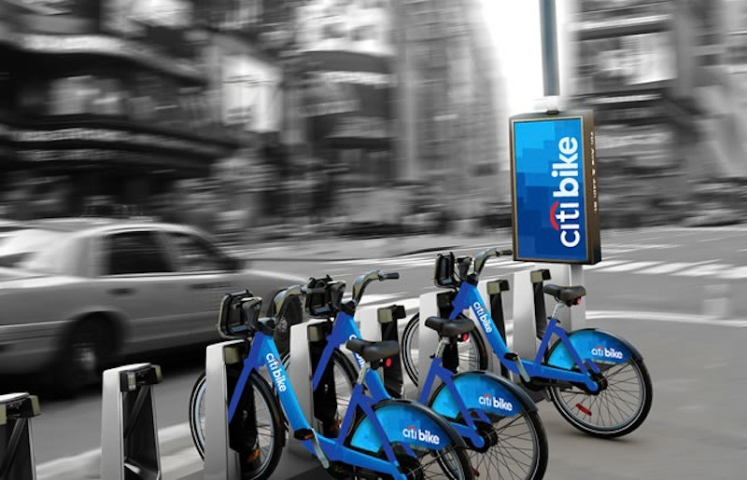
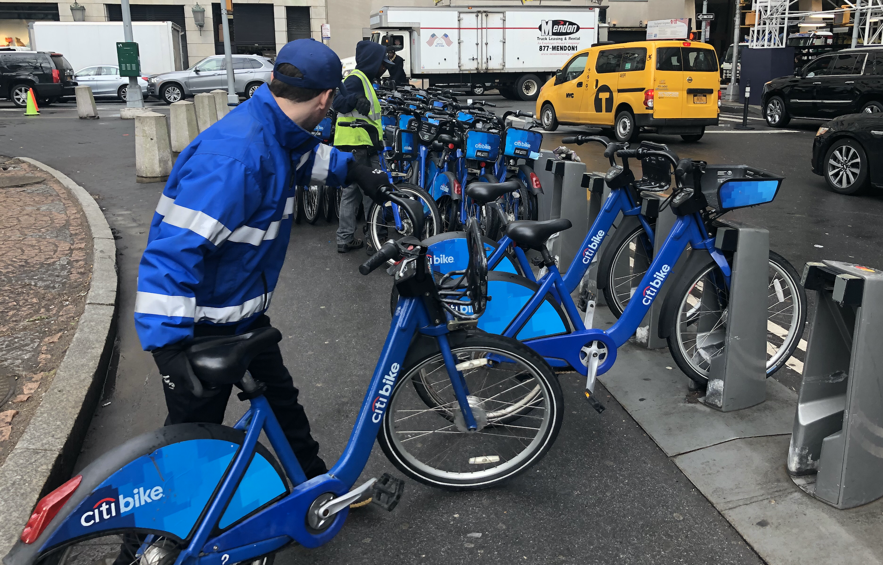
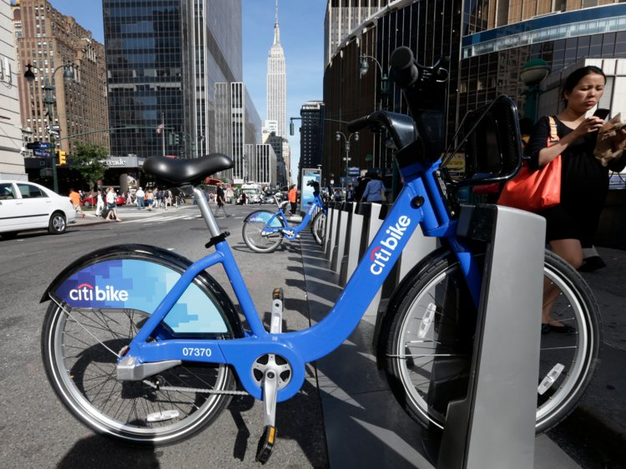
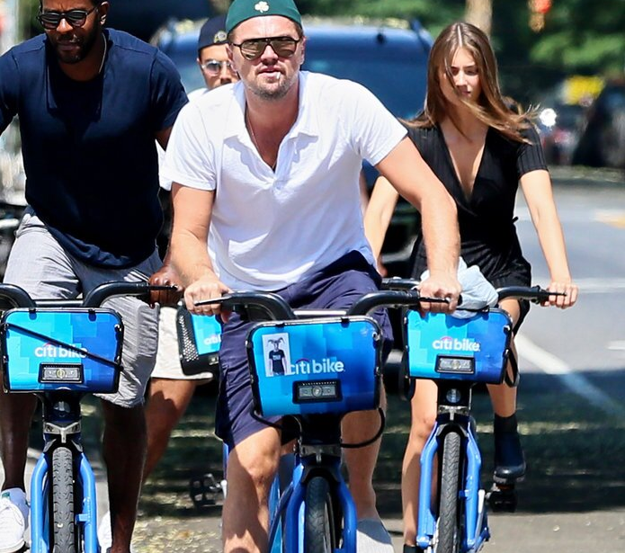



CitiBike Overview
Convenient & popular bike sharing program in NY with over 800 stations
Uneven bike distribution at CitiBike locations in New York
Not having enough bikes or having too many bikes is costly
How many bikes should we remove or add per hour from a location?

Slide 4


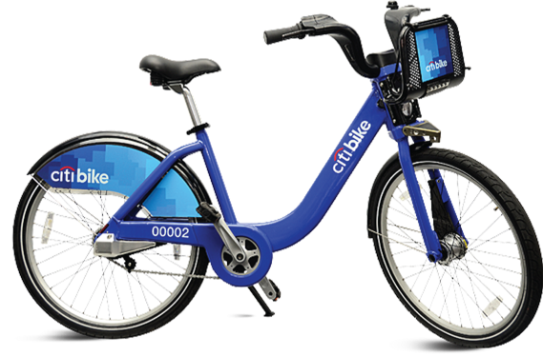
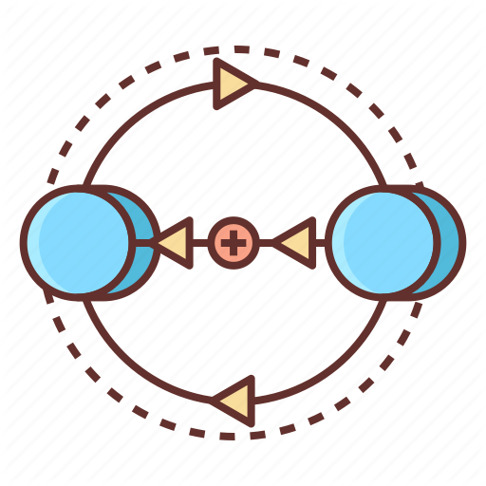

Environment
Location
W 82nd & Central Park West
(Central Park, New York City)
Reward function
Based on stock threshold per hour, movement of bikes
State Transition
Action space
3 months of usage history for every hour of the day
Add/remove bikes or do nothing per hour at the station

Slide 5
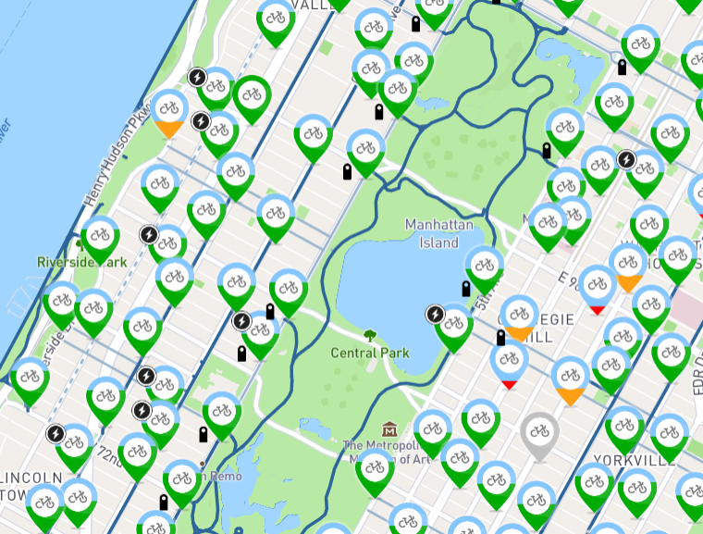


Problem Specification
Location overview:
Central Park Location: 0 - 45 capacity
Overstock: above 45
Understock: below 0
Starting stock: 20 bikes every episode
1 Episode = 24 steps (24 hours)
Location
State Transition
Action space
Reward function

Slide 6
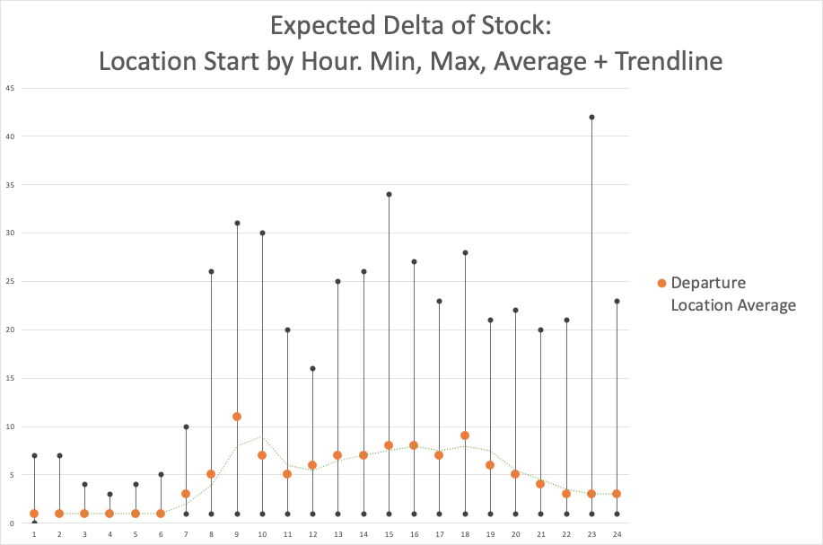
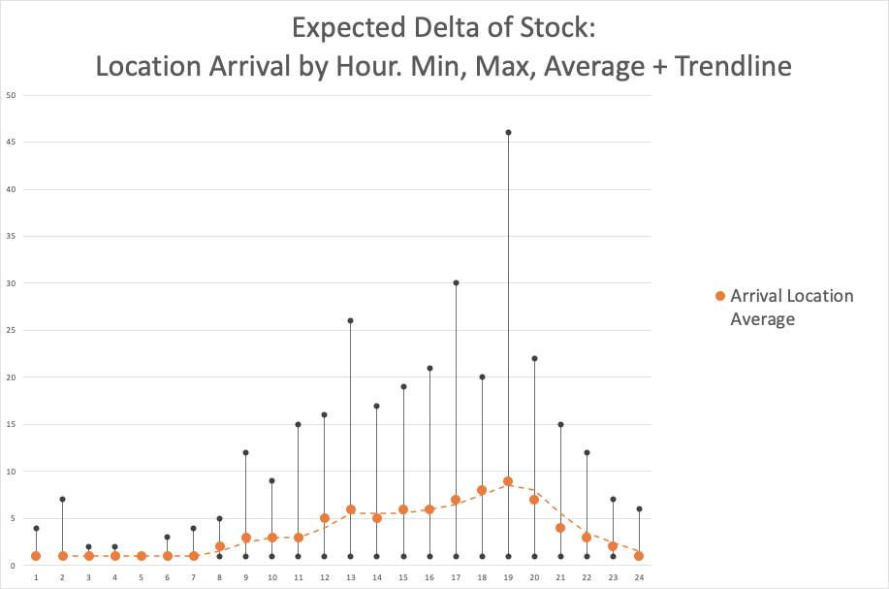
Problem Specification
Expected Stock Generation:
Difference between arrival and departure of bikes is the per hour net expected stock.
Historical mean and standard deviation to generate a random number
Both arrival and departure at given hour
Location
State Transition
Action space
Reward function

Slide 7
Problem Specification
Action Set:
Expected stock is random, action space needs to reflect it
Small number of bikes in action set isn’t effective
7 possible actions per hour: add, remove or do nothing
+/- 30
+/- 20
+/- 10
0
Location
State Transition
Action space
Reward function

Slide 8
Problem Specification
Rewards
Threshold set to 5-40, ensure minimum number of bikes and parking spots
-0.5 reward for every bike moved per hour to minimize movement
-30 reward applied if threshold not met at the end of hour
0 if threshold met at the end of hour
Location
State Transition
Action space
Reward function

Slide 9
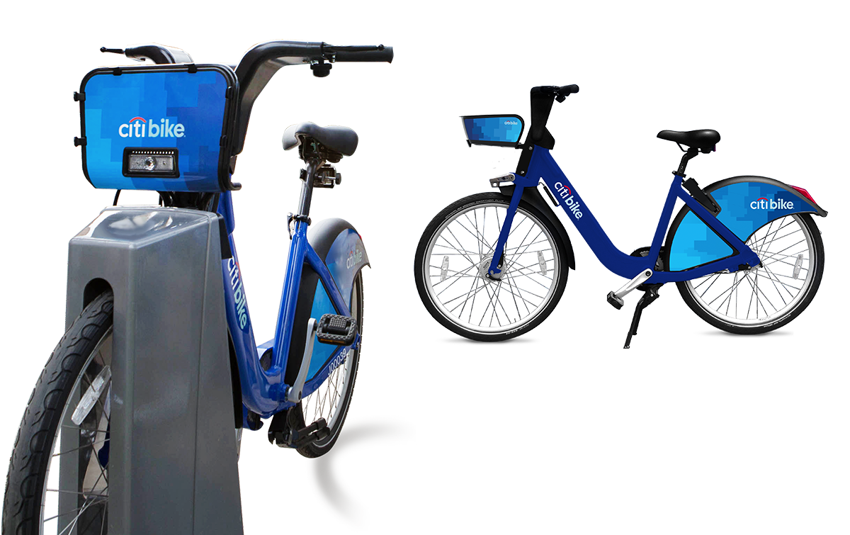
Solving the problem
RL Algorithm
Settings
Evaluation
Q-learning (off policy)
VS
SARSA (on policy)
Epsilon = 0.1/0.01
Discount Factor = 0.9/0.1
Episodes = 100 – 20k
Session success rate
Average rewards/ session
Stock history
Approach – “Ablation Study”
Start with a base method: Q learning
Compare w/ random policy & “do nothing” agent
Compare base method with SARSA
Tune hyperparameters one at a time for both

Slide 10
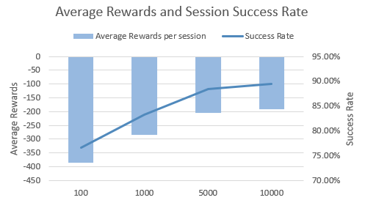
Q learning – Base Method
Average Rewards & Session Success Rate
Algorithm: Q Learning
Epsilon : 0.1
Discount factor: 0.9
Learning rate: 0.01
Sessions: 4
[100, 1k, 5k, 10k]
Actions:
+/- 0,10, 20, 30
Threshold
5 - 40 bikes

Slide 11
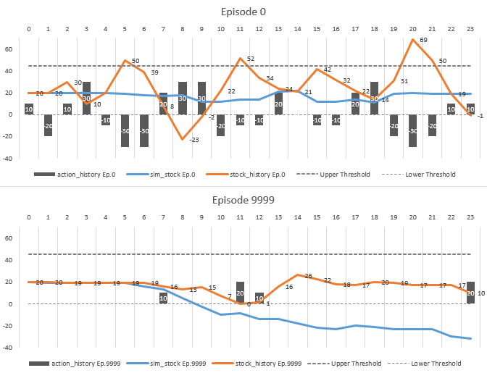
Q learning – Base Method
Stock History
Algorithm: Q Learning
Epsilon : 0.1
Discount factor: 0.9
Learning rate: 0.01
Sessions: 4
[100, 1k, 5k, 10k]
Actions:
+/- 0,10, 20, 30
Threshold
5 - 40 bikes

Slide 12
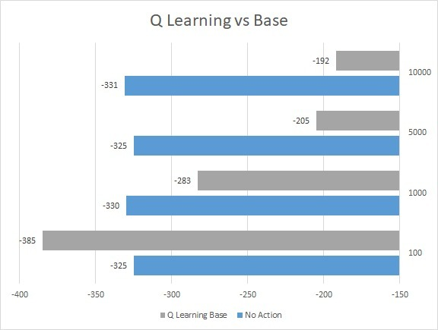
Q learning – No actions
Average reward per session
Algorithm: Q Learning
Epsilon : 0.1
Discount factor: 0.9
Learning rate: 0.01
Sessions: 4
[100, 1k, 5k, 10k]
Actions:
0
Threshold
5 - 40 bikes

Slide 13
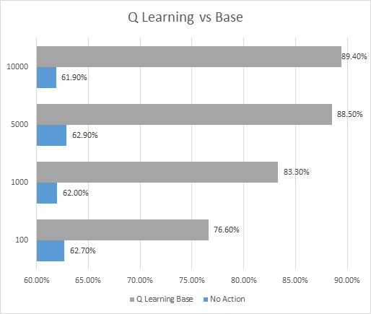
Q learning – No actions
Session success rate
Algorithm: Q Learning
Epsilon : 0.1
Discount factor: 0.9
Learning rate: 0.01
Sessions: 4
[100, 1k, 5k, 10k]
Actions:
0
Threshold
5 - 40 bikes

Slide 14
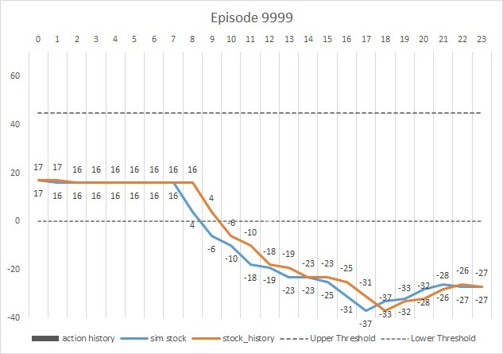
Q learning – No actions
Stock history
Algorithm: Q Learning
Epsilon : 0.1
Discount factor: 0.9
Learning rate: 0.01
Sessions: 4
[100, 1k, 5k, 10k]
Actions:
0
Threshold
5 - 40 bikes

Slide 15
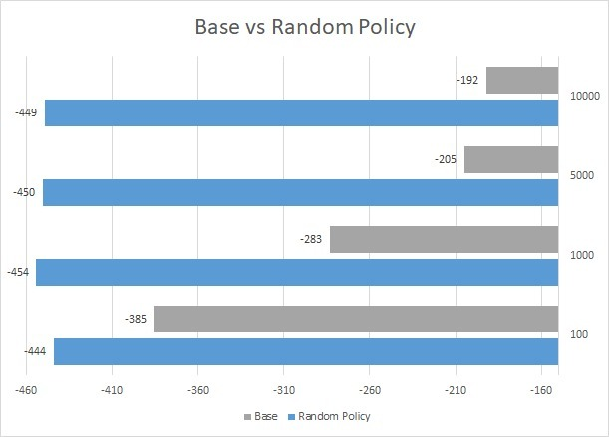
Q learning – Random Policy
Average Rewards per session
Algorithm: Q Learning
Epsilon : 0.9
Discount factor: 0.9
Learning rate: 0.01
Sessions: 4
[100, 1k, 5k, 10k]
Actions:
+/- 0,10, 20, 30
Threshold
5 - 40 bikes

Slide 16
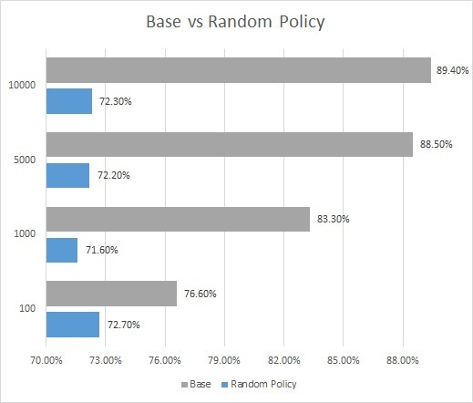
Q learning – Random Policy
Session Success Rate
Algorithm: Q Learning
Epsilon : 0.9
Discount factor: 0.9
Learning rate: 0.01
Sessions: 4
[100, 1k, 5k, 10k]
Actions:
+/- 0,10, 20, 30
Threshold
5 - 40 bikes

Slide 17
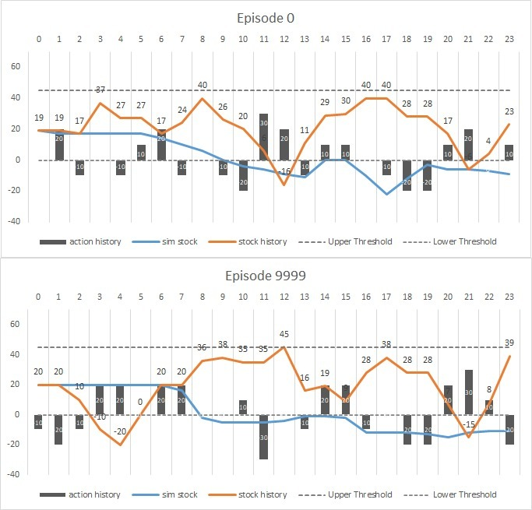
Q learning – Random Policy
Stock history
Algorithm: Q Learning
Epsilon : 0.9
Discount factor: 0.9
Learning rate: 0.01
Sessions: 4
[100, 1k, 5k, 10k]
Actions:
+/- 0,10, 20, 30
Threshold
5 - 40 bikes

Slide 18
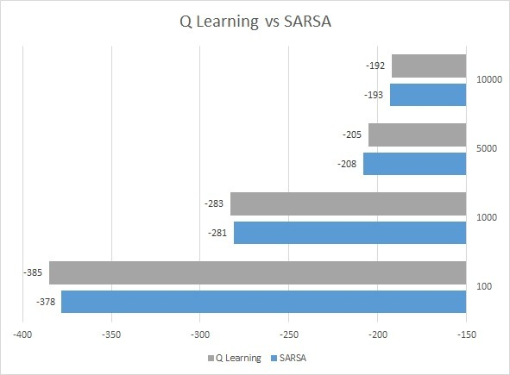
Q learning vs SARSA
Average reward per session
Algorithm: Q Learning vs SARSA
Epsilon : 0.1
Discount factor: 0.9
Learning rate: 0.01
Sessions: 4
[100, 1k, 5k, 10k]
Actions:
+/- 0,10, 20, 30
Threshold
5 - 40 bikes

Slide 19
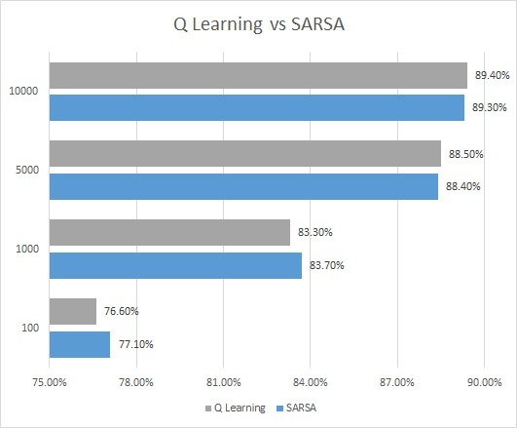
Q learning vs SARSA
Session Success Rate
Algorithm: Q Learning vs SARSA
Epsilon : 0.1
Discount factor: 0.9
Learning rate: 0.01
Sessions: 4
[100, 1k, 5k, 10k]
Actions:
+/- 0,10, 20, 30
Threshold
5 - 40 bikes

Slide 20
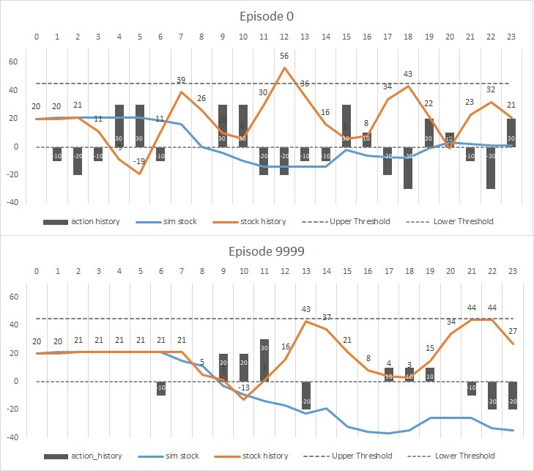
Q learning vs SARSA
Stock History
Algorithm: Q Learning vs SARSA
Epsilon : 0.1
Discount factor: 0.9
Learning rate: 0.01
Sessions: 4
[100, 1k, 5k, 10k]
Actions:
+/- 0,10, 20, 30
Threshold
5 - 40 bikes

Slide 21
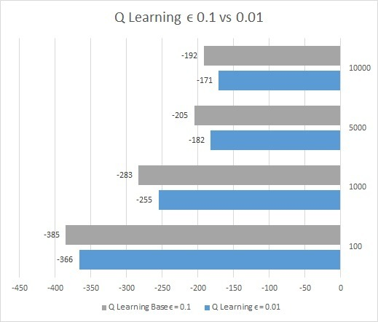
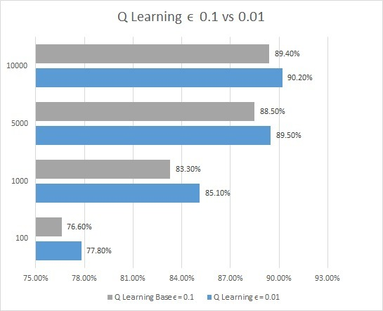
Q Learning Hyperparameter: Epsilon
Average reward
Session Success
Algorithm: Q Learning
Epsilon : 0.01
Discount factor: 0.9
Learning rate: 0.01
Sessions: 4
[100, 1k, 5k, 10k]
Actions:
+/- 0,10, 20, 30
Threshold
5 - 40 bikes

Slide 22
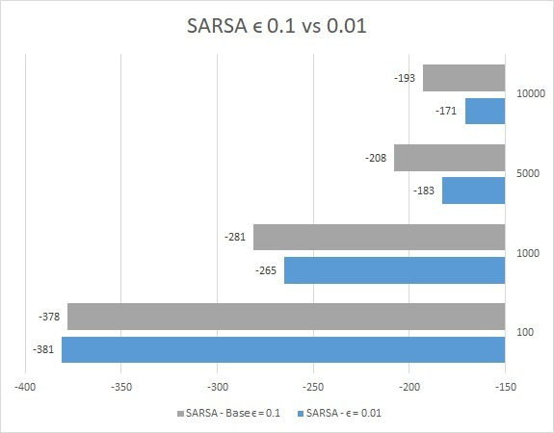
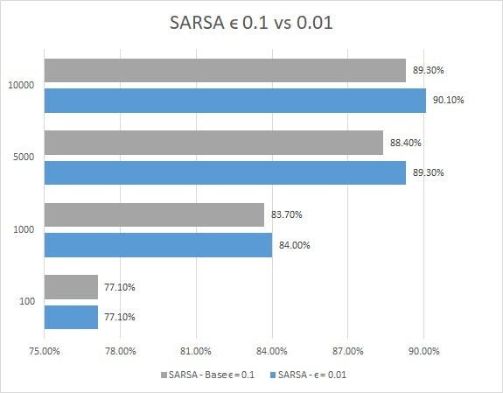
SARSA Hyperparameter: Epsilon
Average reward
Session Success
Algorithm: SARSA
Epsilon : 0.01
Discount factor: 0.9
Learning rate: 0.01
Sessions: 4
[100, 1k, 5k, 10k]
Actions:
+/- 0,10, 20, 30
Threshold
5 - 40 bikes

Slide 23
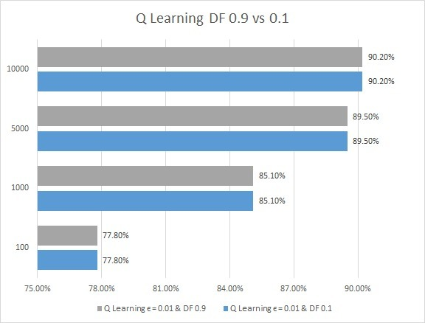
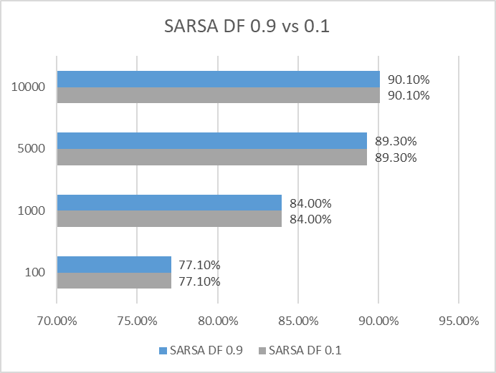
Hyperparameter: Discount Factor
Session Success
Session Success
Algorithm: Q Learning vs SARSA
Epsilon : 0.01
Discount factor: 0.1
Learning rate: 0.01
Sessions: 4
[100, 1k, 5k, 10k]
Actions:
+/- 0,10, 20, 30
Threshold
5 - 40 bikes

Slide 24
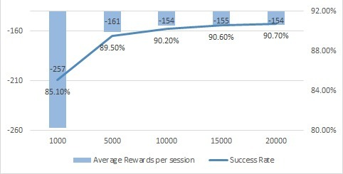
Training time – Q Learning
Avg reward & Session Success
Algorithm: Q Learning
Epsilon : 0.01
Discount factor: 0.9
Learning rate: 0.01
Sessions:
[1 - 20k]
Actions:
+/- 0,10, 20, 30
Threshold
5 - 40 bikes

Slide 25
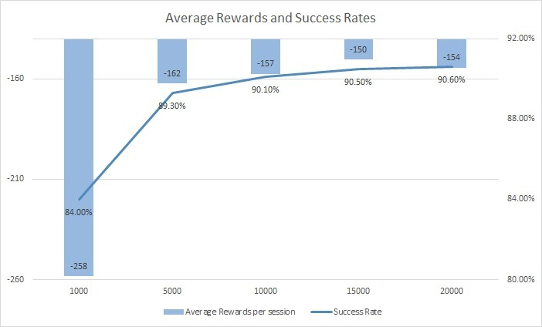
Training time – SARSA
Avg reward & Session Success
Algorithm: SARSA
Epsilon : 0.01
Discount factor: 0.9
Learning rate: 0.01
Sessions:
[1 – 20k]
Actions:
+/- 0,10, 20, 30
Threshold
5 - 40 bikes

Slide 26
Best Method
Epsilon | DF | LR | Sessions | Success
0.1 | 0.9 | 0.01 | 10,000 | 89.40%
0.01 | 0.9 | 0.01 | 10,000 | 90.20%
0.01 | 0.1 | 0.01 | 10,000 | 90.20%
0.01 | 0.9 | 0.01 | 20,000 | 90.70%
Epsilon | DF | LR | Sessions | Success
0.1 | 0.9 | 0.01 | 10,000 | 89.30%
0.01 | 0.9 | 0.01 | 10,000 | 90.10%
0.01 | 0.1 | 0.01 | 10,000 | 90.10%
0.01 | 0.9 | 0.01 | 20,000 | 90.60%
Q Learning
SARSA

Slide 27
Best Method
Epsilon | DF | LR | Sessions | Success
0.1 | 0.9 | 0.01 | 10,000 | 89.40%
0.01 | 0.9 | 0.01 | 10,000 | 90.20%
0.01 | 0.1 | 0.01 | 10,000 | 90.20%
0.01 | 0.9 | 0.01 | 20,000 | 90.70%
Epsilon | DF | LR | Sessions | Success
0.1 | 0.9 | 0.01 | 10,000 | 89.30%
0.01 | 0.9 | 0.01 | 10,000 | 90.10%
0.01 | 0.1 | 0.01 | 10,000 | 90.10%
0.01 | 0.9 | 0.01 | 20,000 | 90.60%
Q Learning
SARSA

Slide 28
Optimal Policy- Q table
 |  | Stock
 |  | 2 | 6 | 10 | 14 | 20 | 25 | 30 | 36 | 42
Hour | 3 | 10 | 20 | 0 | 10 | 0 | 0 | 0 | -10 | -20
 | 6 | 10 | 0 | 0 | 0 | 0 | 0 | 0 | 0 | -20
 | 10 | 0 | 0 | 0 | 0 | 0 | 0 | 0 | 0 | -10
 | 11 | 0 | 0 | 0 | 0 | 0 | 0 | 0 | 0 | -30
 | 13 | -10 | 0 | 0 | 0 | 0 | 0 | 0 | 0 | 20
 | 16 | -20 | 0 | 0 | 0 | 0 | 0 | 0 | 0 | 20
 | 18 | -20 | 0 | 0 | 0 | 0 | 0 | 0 | 0 | 10
 | 21 | 10 | 0 | 0 | 0 | 0 | 0 | 0 | 0 | -10

Slide 29
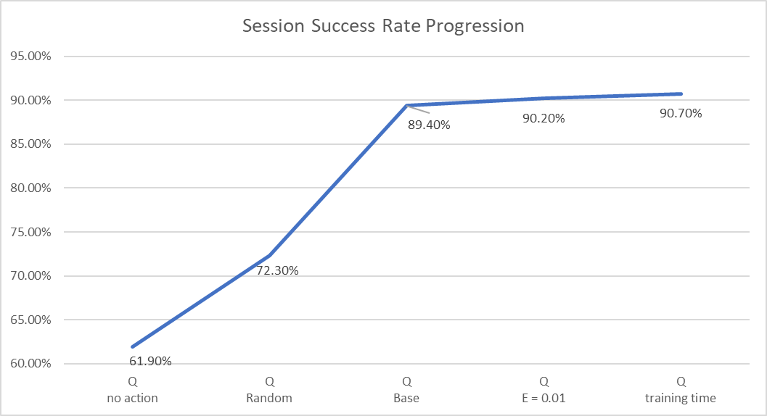
Recap

Slide 30
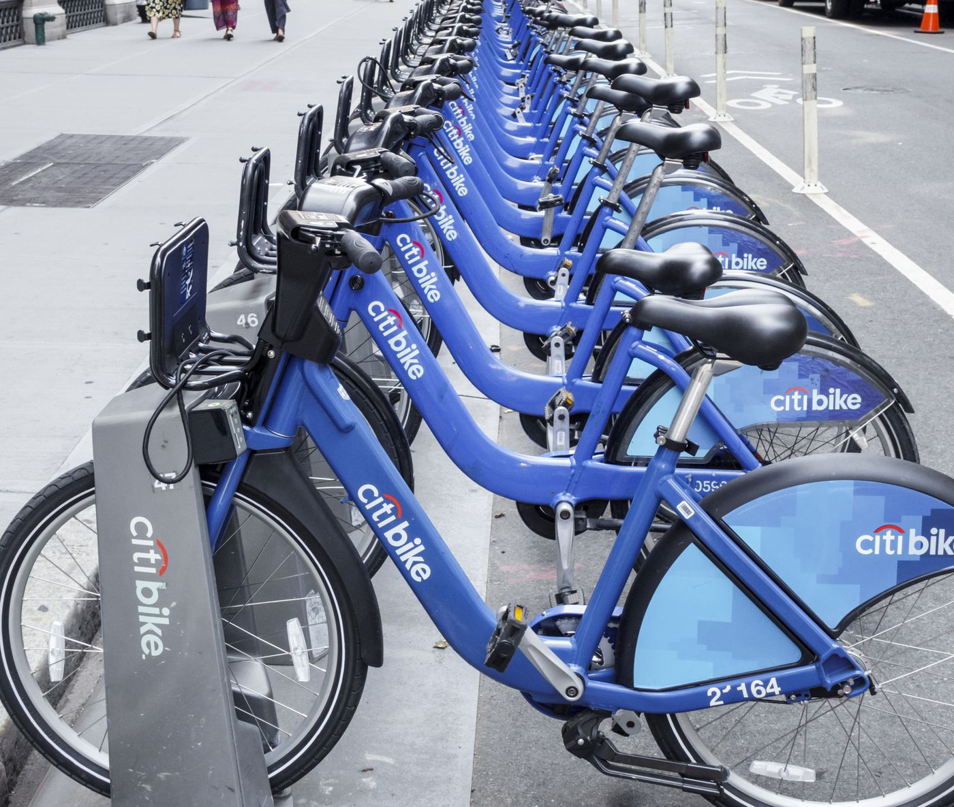
Next Steps
Expected Stock:
Different starting stock
Scale this to a full year
Reward function
Include time of day
No free reset
Different threshold based on hour
RL Algorithms
DQN
Monte Carlo

Slide 31

Thank You!

Slide 32
Appendix
Team Adelaide

Slide 33
Experiments
Algorithm | Action | Episodes | Threshold | Reward | Learning Rate | Epsilon | DF
Q- Learning Base | [-30,-20,-10,0,10,20,30] | 100 - 1K - 5K - 10K | 5 and 40 | 0.5, - 30 | 0.01 | 0.1 | 0.9
Q Learning No action | [0] | 100 - 1K - 5K - 10K | 5 and 40 | 0.5, - 30 | 0.01 | 0.1 | 0.9
Q-Learning random | [-30,-20,-10,0,10,20,30] | 100 - 1K - 5K - 10K | 5 and 40 | 0.5, - 30 | 0.01 | 0.9 | 0.9
SARSA base | [-30,-20,-10,0,10,20,30] | 100 - 1K - 5K - 10K | 5 and 40 | 0.5, - 30 | 0.01 | 0.1 | 0.9
Q-Learning new E | [-30,-20,-10,0,10,20,30] | 100 - 1K - 5K - 10K | 5 and 40 | 0.5, - 30 | 0.01 | 0.01 | 0.9
SARSA new E | [-30,-20,-10,0,10,20,30] | 100 - 1K - 5K - 10K | 5 and 40 | 0.5, - 30 | 0.01 | 0.01 | 0.9
Q-Learning new DF | [-30,-20,-10,0,10,20,30] | 100 - 1K - 5K - 10K | 5 and 40 | 0.5, - 30 | 0.01 | 0.01 | 0.1
SARSA new DF | [-30,-20,-10,0,10,20,30] | 100 - 1K - 5K - 10K | 5 and 40 | 0.5, - 30 | 0.01 | 0.01 | 0.1
Q-Learning new session | [-30,-20,-10,0,10,20,30] | 1K - 10K - 15K - 20K | 5 and 40 | 0.5, - 30 | 0.01 | 0.01 | 0.9
SARSA new session | [-30,-20,-10,0,10,20,30] | 1K - 10K - 15K - 20K | 5 and 40 | 0.5, - 30 | 0.01 | 0.01 | 0.9

Slide 34
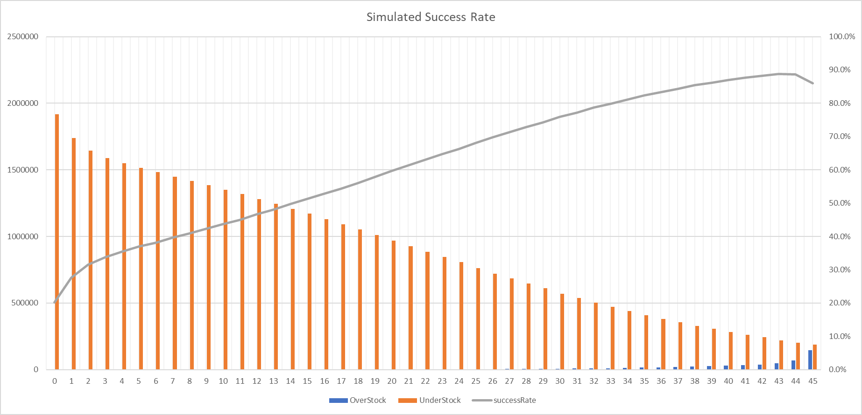
Simulated success vs no action

Slide 35
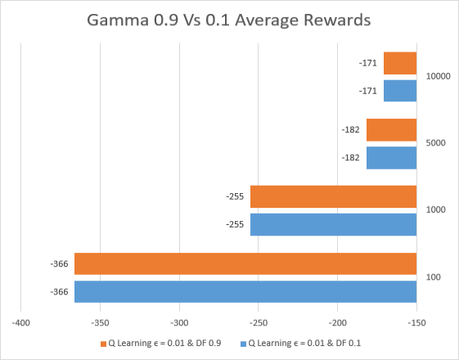
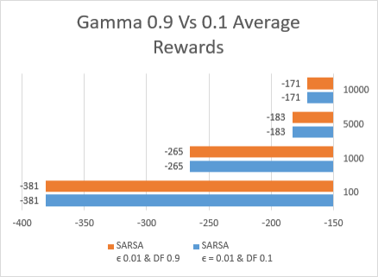
Hyperparameter: Discount factor
Average Reward
Average Reward
Algorithm: Q Learning vs SARSA
Epsilon : 0.01
Discount factor: 0.1
Learning rate: 0.01
Sessions: 4
[100, 1k, 5k, 10k]
Actions:
+/- 0,10, 20, 30
Threshold
5 - 40 bikes

Slide 36
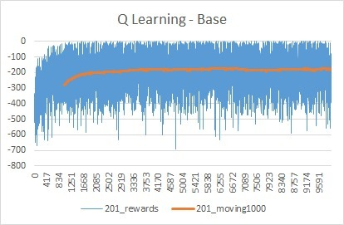
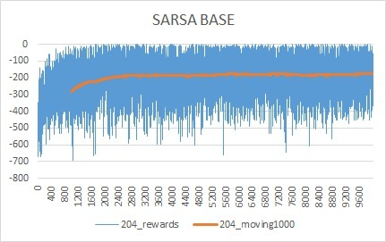
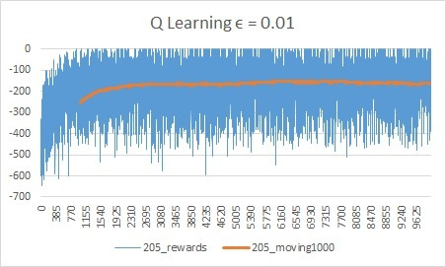
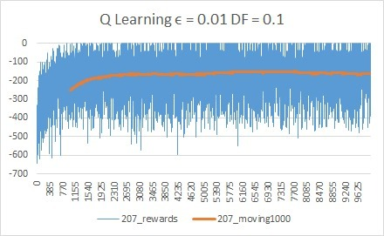
Rewards History

Slide 37
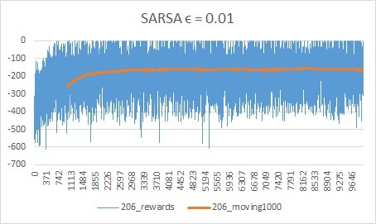
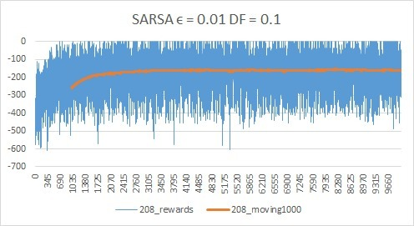
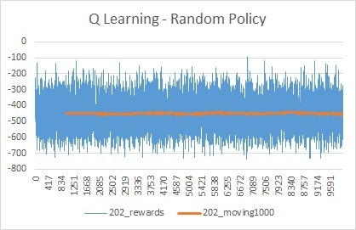
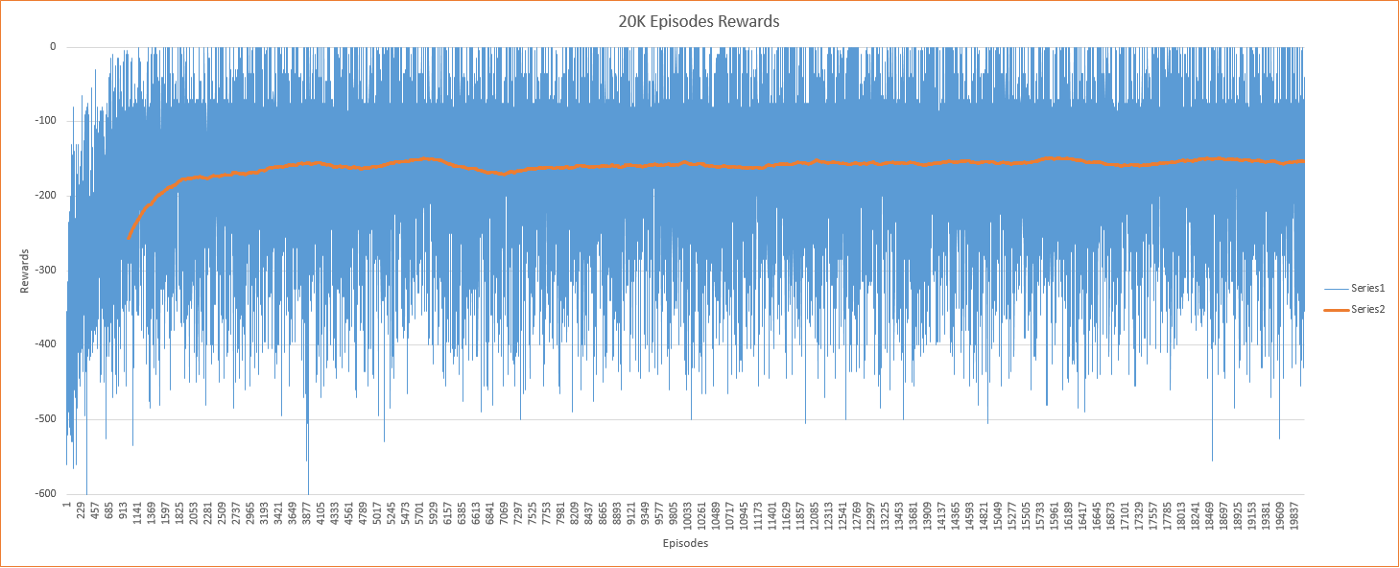
Rewards History
Rewards
Moving 1000

